Slide 1


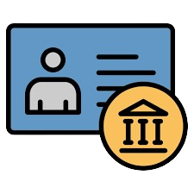



Bank Management System
View Account details
Debit Amount
Credit Amount
Pin Change
Statement
2.User have to log in with Account number & Pin
Display Account details like Name ,Account No, Account type, Amount
1.User have to Register then will get Account no
Debit Amount from Account
Credit Amount to Account
User Login
Change Old to New Pin
Show Statement From starting date to ending Date
Store Every Action like View Account, Debit ,Credit, Pin Change…
View all Users
View complete Account Details of Particular User
View complete Transactions of Particular User
View Complete Transactions of Particular Day
Admin Login
Show all the User details
Admin have to login With Correct Admin ID & Password
Show complete Account Details of Particular User by Account number
Show complete Transactions of Particular User by Account number
Show complete Transactions of Particular Day

Slide 2
Register Form
Username:
User Mobile: User have to enter 10 digits mobile number
User Gender:
Account Type: Salary or Savings
Table Format to store User details
Sno | Username | Mobile no | Gender | Account no | Account Type | Date &Time
Table Format to store All Transactions details
Sno | Account no | Action(Transaction or Pine Change) | Date & time

Slide 3
Documentation
1. User Registration: Users register, receive a unique account number, and have details stored.
2. User Login : Users log in securely with account number and password.
3. Deposit : Users can deposit money; transactions are recorded with type, amount, and date.
4. Withdrawal : Users withdraw funds if sufficient balance; transactions recorded with type, amount, and date.
5. Change PIN : Users can update their PIN for added security.
6. Transaction Statement: Users view transaction history with credit, debit, and date details.
7. Admin Login : Admins log in with unique credentials for access to management tools.
8. View All Users : Admins see a list of all registered users with essential details.
9. View Account Details: Admins can access details for specific accounts.
10. View All Transactions: Admins view or filter all user transactions for oversight.

